Slide 1

FIESTA OF CHILDREN’S DAY CELEBRATION
-Aadityaamlan Panda
The valuable assets a nation boasts for,
The tenets of our posterity lie on their shoulder;
The priceless wealth who are adored to the core,
None but the children, both teen and toddler.
The tender insignias of ingenuity and innocence,
The inquisitive beings acknowledged for shyness,
Their fancy dwells around the tecs and angels;
The dreams of the Jovians and buccaneer vessels.
Children’s day is celebrated throughout our nation,
To focus on the health of the younger generation.
By nurturing them we preserve our culture.
By educating them we invigorate the future.
The precious human resource must be well cared of;
By bestowing on them our cordial love.

Slide 2
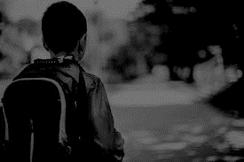
ETHEREAL PEARLS OF ELYSIUM
The valuable assets a nation boasts for,
The tenets of our posterity lie on their shoulder;
The priceless wealth who are adored to the core,
None but the children, both teen and toddler.
The tender insignias of ingenuity and innocence,
The inquisitive beings acknowledged for shyness,
Their fancy dwells around the tecs and angels;
The dreams of the Jovians and buccaneer vessels.
Children’s day is celebrated throughout our nation,
To focus on the health of the younger generation.
By nurturing them we preserve our culture.
By educating them we invigorate the future.
The precious human resource must be well cared of;
By bestowing on them our cordial love.
-Aadityaamlan Panda

